Slide 1



Capstone project Phase A 24-2-D-8 Lior Jigalo Advisor: Shimon Faitelson

Slide 2

Part 1 Introduction

Slide 3





Inspiration
100,000 police reported crashes annually
1500 fatalities reported annually
71,000 injuries reported
40% of drivers admit they have fallen asleep while driving
The Zebra "drowsy-driving-statistics“ January 31, 2023
Notes:
The inspiration for this project speaks for itself.
100 thousand crashes
1500 people are killed
71 thousand injuries reported
About 40% of drivers admitted to falling asleep at the wheel: 10% of those drivers admitted to this behavior in the past year and 27% admitted to this in the past month.

Slide 4

Alertwatch project
The Alertwatch project aims to enhance road safety by monitoring the users face and detecting if the user falls asleep while driving as well as alerting the user.
Notes:
The Alertwatch project comes to make the roads, and other environments safer this project makes emphasis on road safety, monitoring the driver in real time and detecting decline in alertness. And alerting as needed.

Slide 5

Part 2 Existing solutions

Slide 6


Existing solutions
Mobileye Lane sway detection
Smartwatches
Tesla Autopilot
Notes:
The existing solutions are mainly based on reactive solutions like Mobileye, smart watches that monitor your biologic signs and can alert you using haptic feedback. These solutions are not sufficient as we need a proactive solution. Another type of solution is autonomously driving cars, however as you may expect these solutions are rather expensive and not applicable to cars that are already on the roads.

Slide 7

Part 3 Planned Objectives

Slide 8
Proactive alertness management
Rather than reacting to the car being out of the lanes or about to hit something, we want to prevent that by proactively detecting signs of drowsiness in the earliest stage possible.
Notes:
Just like the best defense is offence, A proactive solution should detect drops in alertness at the earliest stage possible, without getting into dangerous situations

Slide 9
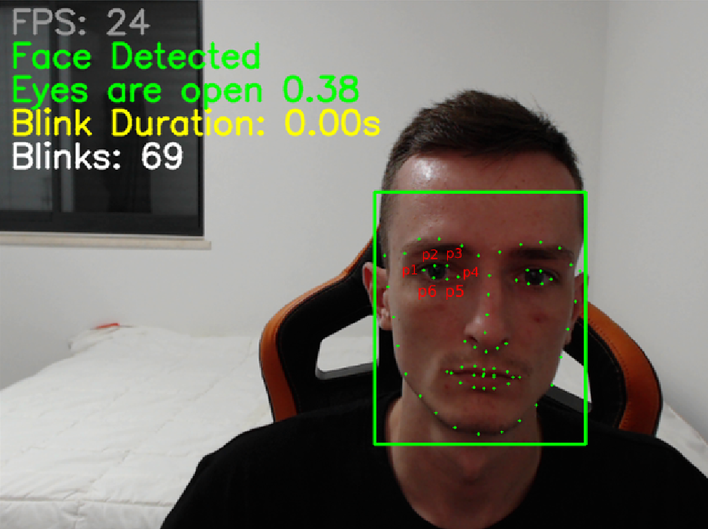

Real-time facial monitoring
The key feature of the system is monitoring, analyzing and assessing the alertness drop based on EAR (eye aspect ratio) values.
$$Eye aspect ratio = \frac{\left|\left|p_{2}−p_{6}\right|−\left|p_{3}−p_{5}\right|\right|}{2\left|p_{1}−p_{4}\right|}$$
Notes:
The key pillar the Alertwatch system holds on, is facial detection and monitoring, allowing us to calculate the EAR (eye aspect ratio) to analyze the alertness of the user. This gives us the openness of the eye.
In addition, we can monitor when the user yawns as well as potentialy where the user is looking, all based on 68 facial landmarks, however that is a stretch goal and is not in the scope of the project.

Slide 10





Versatile deployment across environments
Automotive
Offices
Security
Military
Many Other
Notes:
While mainly focused at the automotive market, Alertwatch can be deployed at a wider range of usages requiring alertness assessment such as offices, security field, military & other critical areas.
You will be right to ask yourselves Why? What’s so special? Which leads us t the next slide.

Slide 11


Fanless & low power EDGE solution
Fanless Design
High performance per watt
Notes:
Utilizing fanless design allows integration in extreme environments such as industrial and military applications, more specifically, the hardware was tested in an oven capable of providing temperatures between -40 to 85 degrees This allows us deploy the machine somewhere and not worry about frequent maintenance
In combination with low power hardware the system can operate efficiently with high performance per watt at a low cost

Slide 12



Runtime environment
Notes:
Alertwatch operates in custom Linux environments built on Yocto & BuildRoot for all its components providing high flexibility and allows utilizing the most out of the hardware while remaining lightweight and fast. YOCTO and BuildRoot are projects that allow us to create custom linux images, however they differ in many things. The main difference being that YOCTO is based on a layered architecture and utilized BitBake as a build system, while Buildroot utilizes single configuration files (defconfig) and uses make and kconfig for build orchestration and configuration

Slide 13
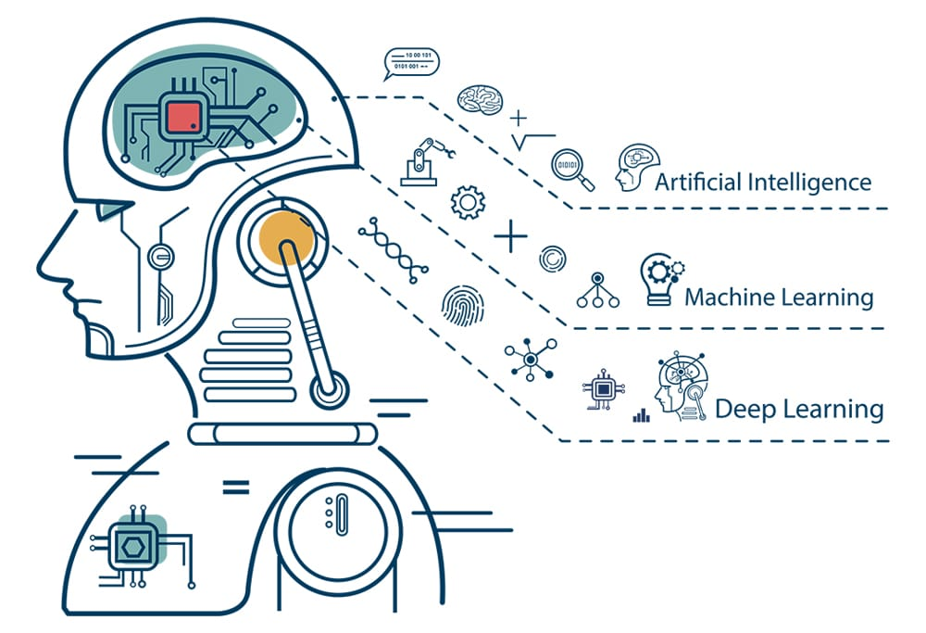

AI usage
PyTorch
SSD
ResNet18
Notes:
The artificial intelligence part of the project consists of 3 main parts, PyTorch, SSD, & Resnet 18 PyTorch is used to build and train the face landmarks detection model based on Resnet18 model, a pre-trained SSD weights model will be used due to its light and small architecture.
What is SSD (Single Shot MultiBox Detector)?
SSD is a deep learning algorithm used for object detection. It detects objects (like faces) in images by predicting bounding boxes and object classes in a single pass through the network making it very small and quick for better FPS.
Alternatively, a Yolov model can be used.
Why ResNet18 and not ResNet50? Lower computational complexity, faster inference, providing higher frame per second value which is crucial, although ResnNet50 would have probably given more accurate results, at a higher power consumption level, ResNet18 provides sufficient accuracy.

Slide 14
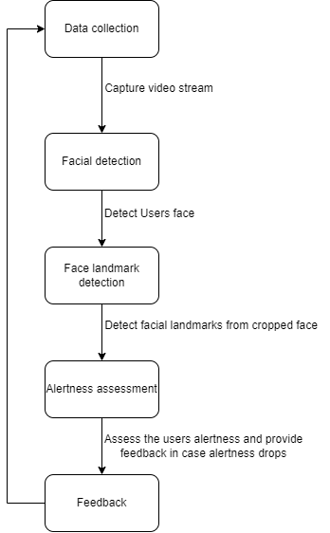
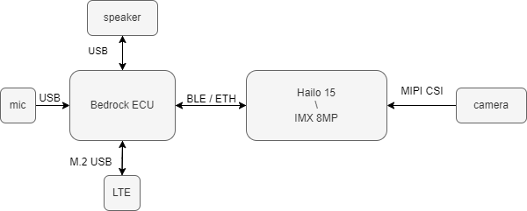
Data Flow & Architecture
Notes:
Data flow is shown in the left diagram. We can see that 2 AI models are used, first for facial detection, then the face is being cropped and facial landmarks are being predicted on the cropped face of 224x224 pixels in grayscale.
The block diagrams on the right shows the hardware components used in the project. Utilizing a bedrock pc for ECU simulation, and a Hailo15 board for the detection unit.

Slide 15
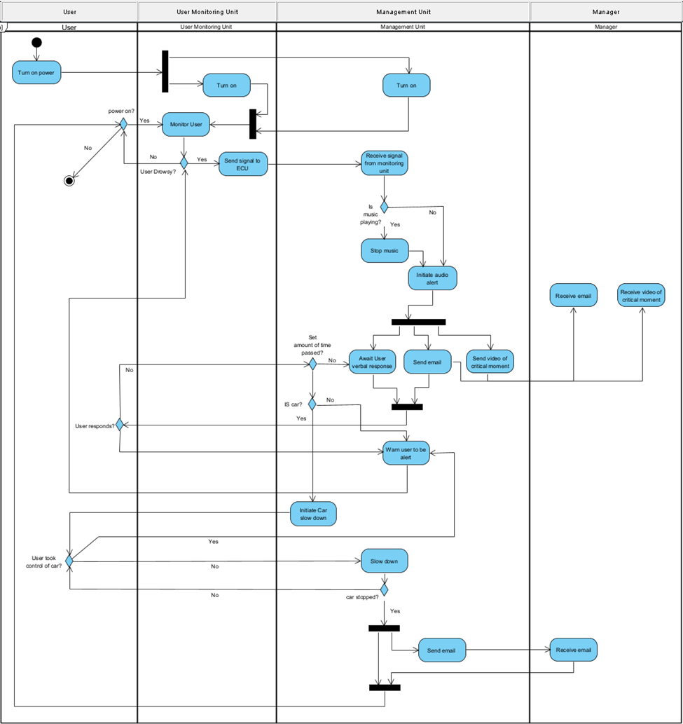

Slide 16

Part 4 Hardware options

Slide 17
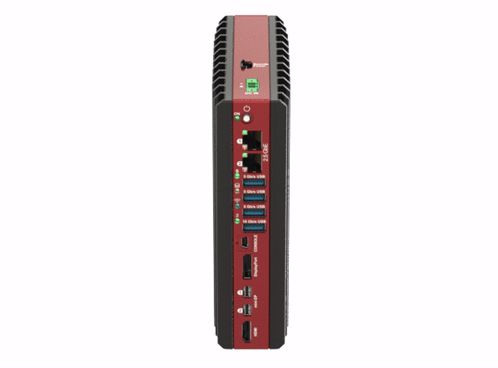

SolidRun Bedrock R7000
Feature | Spec
CPU | AMD Ryzen™ 7040 Series 8C\16T
Temperature range | Industrial -40ºC to 85ºC
Enclosure | All aluminum enclosure Patented fanless cooling
Great performance per watt
Highly configurable
More info
Notes:
The Bedrock R7000 is a powerful AMD based product and can easily pose as an ECU, its flexible power controls allows tuning the device for the specific needs of the project to provide good performance with as little power consumption as possible.
Its Industrial temperature range and patented passive cooling solution allow it to be deployed in various extreme environments.

Slide 18
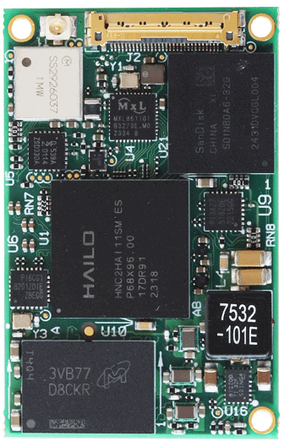
SolidRun Hailo 15H
Feature | Spec
CPU | 4 x Cortex A53 @ 1.3GHz
AI Acceleration | 20 TOPs on Hailo 15H SOM Hailo patented
Temperature range | Industrial -40ºC to 85ºC
Size | 47x30mm
More info
Notes:
The Hailo 15H CPU features a powerful integrated 20 TOPS NPU allowing to provide great AI Inference performance, while consuming very little power. The small form factor of the SOM allows development of a custom carrier board tailored specifically for this projects needs, However, unfortunately, this is not in the scope of the project.

Slide 19
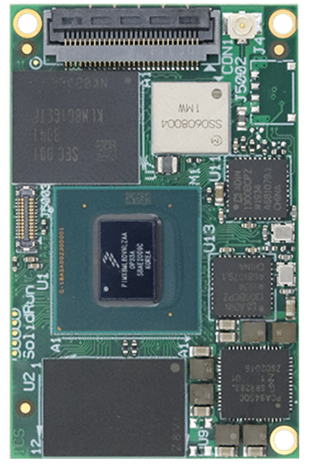
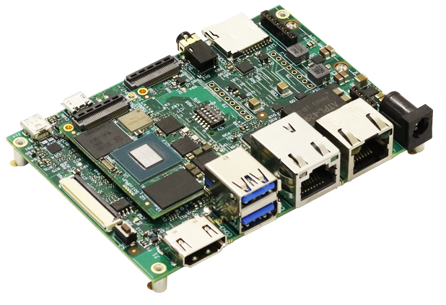
SolidRun i.MX 8MP
Feature | Spec
CPU | NXP i.MX 8M Plus 4x Arm® Cortex®-A53 @1.8 GHz
Temperature range | Industrial -40ºC to 85ºC
Size | 47x30mm
More info
Notes:
The third and last option, is a bit more flexible, allowing to use an IMX8M plus SOM, with Hailo PCI express acceleration cards, such as Hailo 8 or Hailo 10 (unreleased yet) for tuning. Although its small form factor, its reliability on extension modules for inference do not allow for much flexibility for overall size of a custom carrier.

Slide 20

Part 5 Challenges & constraints

Slide 21
Software challenges
Hailo’s infrastructure lacks a wide community
Hailo’s tools are complex to understand
AI model training to a sufficient level requires resources
Notes:
Hailo is a new company funded in 2019, their community forum was launched about 6 months ago.
Naturally, their community is not established yet.
Hailo’s software is complex and hard to understand as the process is very complex.
Training the current model took 7 full days to train to a good level with a GTX 1060

Slide 22
Hardware constraints
Low power consumption limits performance
The scope of the project does not allow development of a custom carrier board
Notes:
The hardware being low power limits the performance we can get
The project does not allow for development of a custom carrier board, therefore, the evaluation board will be used.

Slide 23
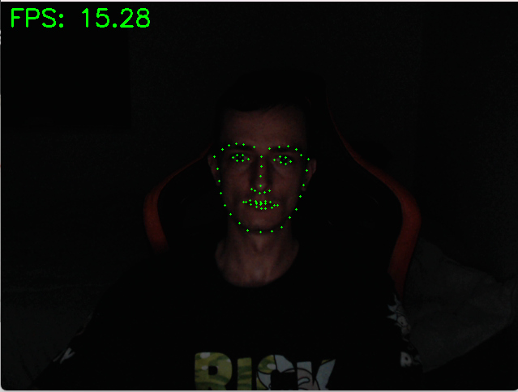
Physical Challenges
Sunglasses prevents detection
Lighting conditions
Notes:
An obvious limitation of the system is if the user is wearing sunglasses the camera will not be able to see the users eyes, however, if its light enough for you to need sunglasses chances are, you’re not sleeping. Another limitation is lighting conditions, relying on a camera in dark environments can be challenging, however from tests ran, the system can detect facial landmarks in dark environments. Also, the inference runs on 224x224 grayscale images, which allows integration of an infra red camera solving this issue altogether. However, this will not be implemented in the project.

Slide 24

Part 6 Testing Plan

Slide 25
Hardware Validation
Category | Test | Expected result
Reliability | Oven testing in -40ºC to 85ºC | Stable system with no crashes
Stability | MemTester | Stable system with memory errors
Functionality | Overall interface testing | All interfaces are functional
AI usage | NPU self diagnosis | Firmware is able to communicate with NPU
Notes:
In hardware responsible for safety, stability is crucial, both in terms of hardware and software. The hardware is to be testen in an oven between -40 degrees to 85 degrees Celsius, and should not have any memory errors while running memtester.
Also, Hailos firmware allows self diagnosis of the hardware which allows us to assess the state of the hardware while using the system.

Slide 26
Software Validation
Category | Test | Expected result
Connectivity | Communication between system components | All system components receive and transmit data with no packet loss
Detection | Face detection | The user’s face is detected
Detection | Face landmarks detection | Face landmarks are detected from the cropped face image
Accuracy | Face landmarks Placement | Face landmarks accurately placed on the cropped face image
Functionality | Alertness drop detection | Accurate detection of alertness drop of more than 20%
Notes:
Mainly relying on detection for this project, the emphasis on correct data transfer, and accurate face detection and landmark placement is crucial for the systems reliability.

Slide 27
Thank you!

Slide 28
Additional information

Slide 29

SolidRun Bedrock R7000
Feature | Spec
CPU | AMD Ryzen™ 7040 Series 8C\16T
GPU | AMD Radeon™ 780M
AI Acceleration | Up to 3x Hailo-8 M.2 AI Inferencing Acceleration Module 26 TOPS Up to 2x Hailo-10 M.2 Generative AI Acceleration Module 40 TOPS
Temperature range | Industrial -40ºC to 85ºC
Enclosure | All aluminum enclosure, fanless cooling
Main voltage | 12V - 68V
Continue presentation

Slide 30
SolidRun Hailo 15H
Feature | Spec
CPU | 4 x Cortex A53 @ 1.3GHz
GPU | N/A
AI Acceleration | 20 TOPs on Hailo 15H SOM Hailo patented structure defined dataflow architecture
Temperature range | Industrial -40ºC to 85ºC
Enclosure | N/A
Main voltage | 5V
Size | 47x30mm
Continue presentation

Slide 31
SolidRun i.MX 8MP
Feature | Spec
CPU | NXP i.MX 8M Plus 4x Arm® Cortex®-A53 @1.8 GHz
GPU | Vivante GC7000UL
AI Acceleration | Up to 3x Hailo-8 M.2 AI Inferencing Acceleration Module 26 TOPS Up to 2x Hailo-10 M.2 Generative AI Acceleration Module 40 TOPS
Temperature range | Industrial -40ºC to 85ºC
Enclosure | N/A
Main voltage | 5V
Size | 47x30mm
Continue presentation

